Slide 1
Content-based image retrieval
Data mining and semantic web
Matija Lukić
matija32@gmail.com
School of Electrical Engineering
University of Belgrade
31 March 2011
This material was developed with financial help of the WUSA fund of Austria.

Slide 2
Agenda
The problem - image retrieval
Traditional methods
CBIR
Definition
Sample algorithm
CBIR by Indexing Random Subwindows with Randomized trees
Other modern methods and comparison to CBIR
Applications of CBIR
Search engines

Slide 3

Image retrieval
Browsing, searching and retrieving images from a large database of digital images.

Slide 4

Traditional methods
Adding metadata to images
Image annotation is needed
Captioning
Keywords
Description
Tagging
A tag cloud with terms related to Web 2.0

Slide 5
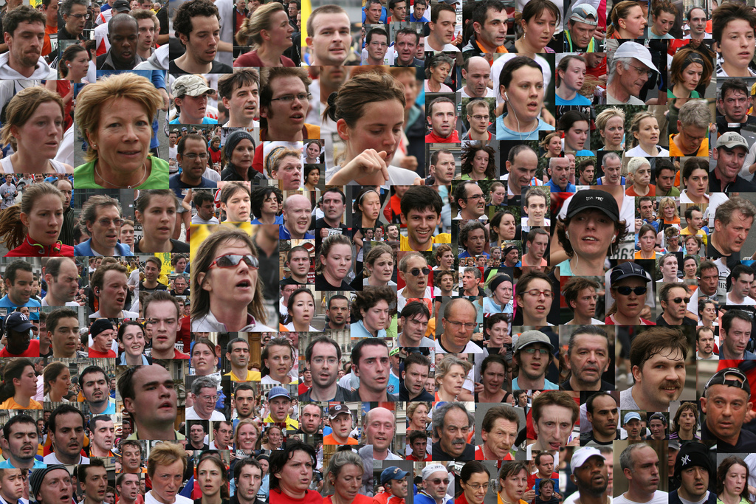

Manual image annotation
Sometimes it’s hard to describe image with words
Different perception of things
Time-consuming,
Laborious and
Expensive
“Guys, tag yourself! ☺”

Slide 6
Content-based image retrieval
What do some clever guys say about it?
“It’s a technique for retrieving images on the basis of automatically-derived features such as colour, texture and shape.”
“Given a reference database of unlabeled images, it retrieves images similar to a new query image based only on visual content.”
“It avoids using textual descriptions and instead retrieves images based on their visual similarity to:
a user-supplied query image or
user-specified image features.”

Slide 7
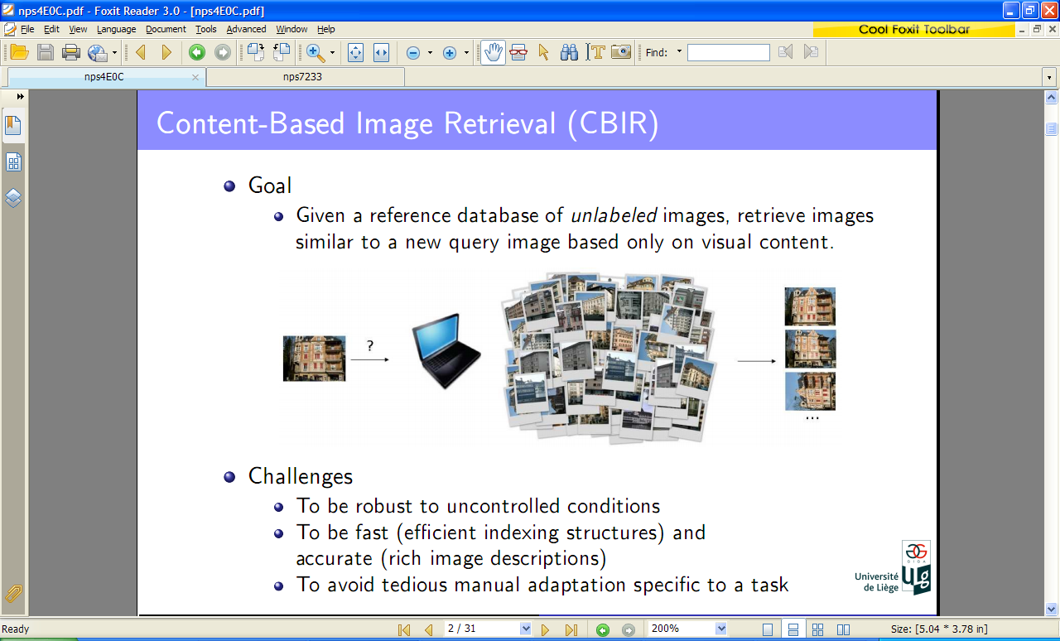
Content-based image retrieval
Challenges
To be fast (efficient indexing structures)
To be accurate (rich image descriptions)
Avoiding tedious manual adaptations specific to a task

Slide 8

One way to do to CBIR is…
… by Indexing Random Subwindows with Randomized Trees
Have no clue what this is?
Let’s see what does it mean…

Slide 9
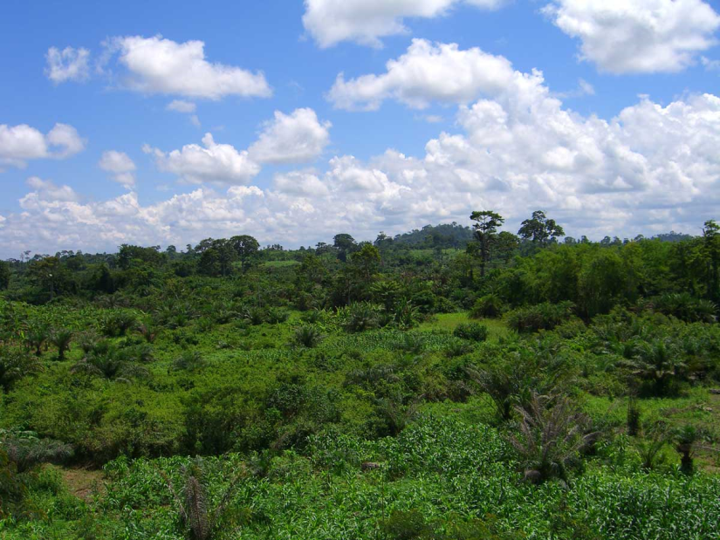
Algorithm overview
Content-based image retrieval by indexing random subwindows with randomized trees
Detector
random subwindows
Descriptor
subwindow raw pixel value
Indexing subwindows
totally randomized trees
Image similarity measure
derived from similarity measure between subwindows deﬁned by tree

Slide 10

Image detection
Some methods considered neighborhood
Corners
Lines
Edges
Contours
Homogeneous regions
… and use them to classify images
Problems:
Not capturing enough information
Most detectors are complementary:
some where more adapted to structured scenes,
while others to textures

Slide 11

Image detection
Here, subwindow random sampling scheme is used:
Square patches of random sizes are extracted at random location in image
Resized
By bilinear interpolation
To the same size (16 x 16)
Subwindows’ raw pixel values:
HSV values for color images
vector length = 16 x 16 x 3 = 768
Gray intensities for grayscale images
vector length = 16 x 16 = 256

Slide 12
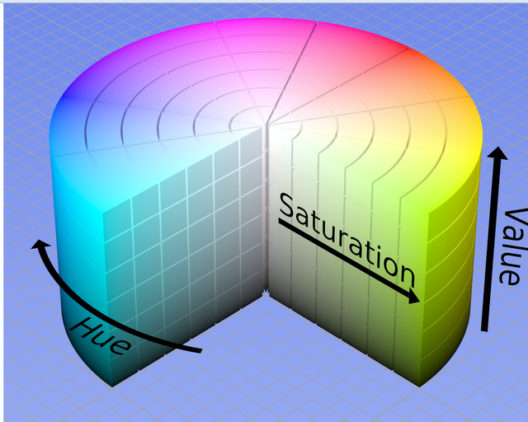
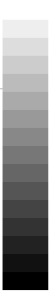
HSV values / Grayscale

Slide 13
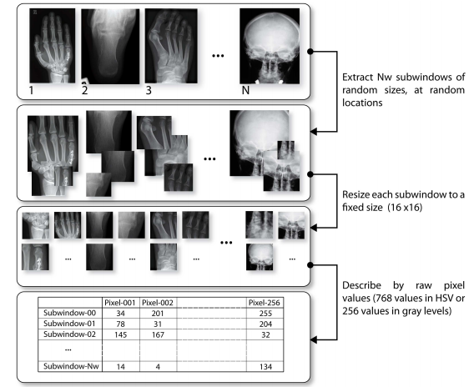
Extraction of random subwindows

Slide 14
Indexing subwindows with totally randomized trees
Recursively partitions the set of subwindows by randomly generated tests
One test goes like this:
Random pixel is selected
Random cut-point value is selected
Subwindow sets are divided, thus creating parent-child relationships between nods (1 test, one parent node)
The recursion goes until
All descriptors are constant in the leaf
The number of subwindows drops below predefined threshold - n_{min}

Slide 15
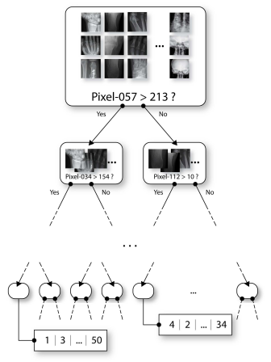
Indexing subwindows with totally randomized trees
Indexing is done for training set
All those images in the DB
A number T of such trees are grown from the training set
O(N * log(N))
N – number of subwindows
Fast creation of indexing structures
Other algorithms use more complex tests, but they are slower

Slide 16
Inducing image similarities
Similarity between two subwindows (one tree)
A tree τ deﬁnes similarity between subwindows s and s’
k_{τ} (s, s’) =
Two subwindows are very similar if they fall in a same leaf that has a very small subset of training subwindows
if s and s’ reach the same leaf L containing N_{L} subwindows
otherwise

Slide 17
Inducing image similarities
Similarity between two subwindows (ensemble of T trees)
Defined by:
Two subwindows are similar if they are considered similar by a large portion of trees

Slide 18
Inducing image similarities
Similarity between two images
Similarity of images I and I’
The similarity between two images is thus average similarity between pairs of their subwindows
In practice, fixed number of subwindows is extracted for each image

Slide 19
Finding similar images
Create N_{ls} subwindows of query image Iq
Resize them to 16x16
Take each of them and run them through each tree from randomized tree ensemble
For each of those runs, when a certain leaf is reached, for each reference image Ir (images from the database) k(Iq, Ir) value is incremented by N_{Ir,L}/N_{L}, where:
N_{Ir,L} – stands for number of subwindows of reference image Ir in the tree leaf L
N_{L} - Total number of subwindows in the leaf L
Normalization and whichever image is closest to one, wins!

Slide 20
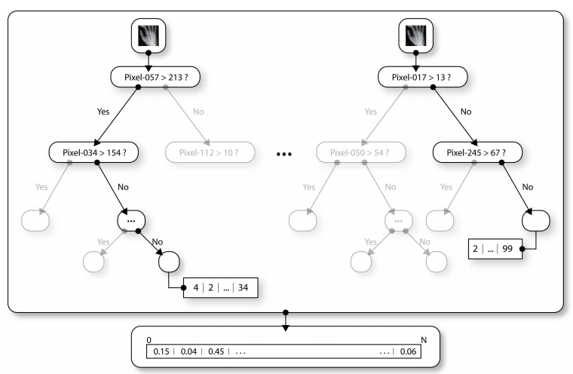
Finding similar images

Slide 21
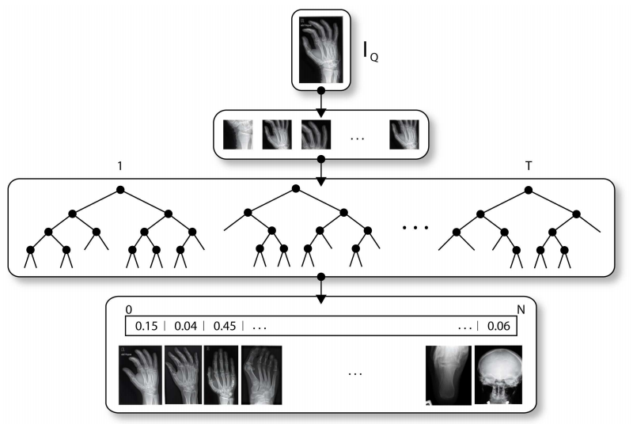
Finding similar images

Slide 22
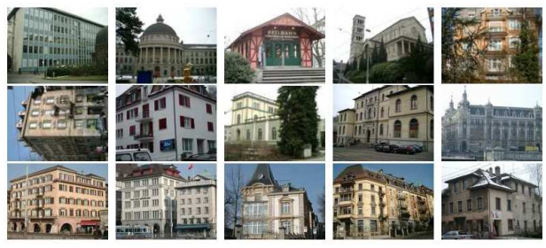
Experiment 1/2 (ZuBuD)
1005 reference images (640 x 480)
115 test images (320 x 240)
10 trees, 1000 subwindows per image, n_{min} = 2

Slide 23
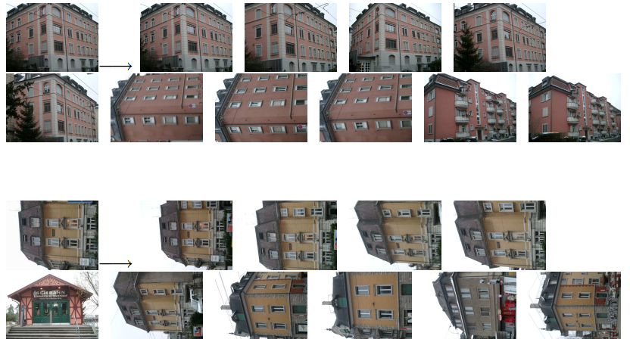
Experiment 1/2 (top 10 hits)

Slide 24
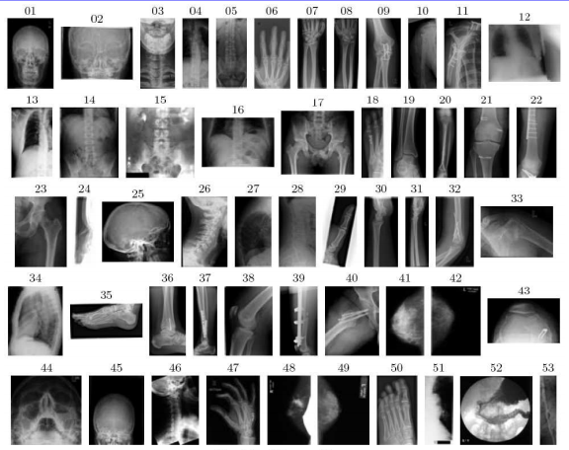
Experiment 2/2 (IRMA)
Reference images:
- 9000 (512 x 512)
Test images
- 1000
Parameters:
- 10 trees
- 1000 subwindows per image
- n_{min} = 2

Slide 25
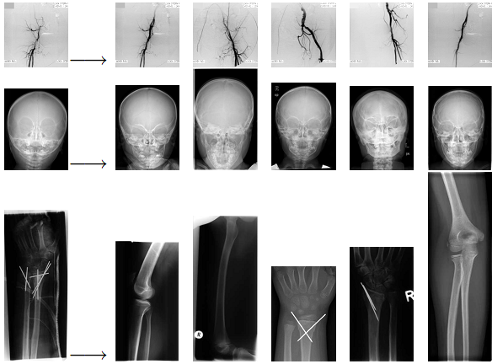
Experiment 2/2 (3 x Top 5)

Slide 26
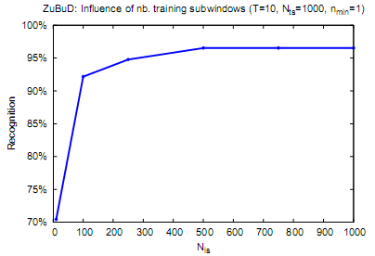
Parameters
Number of training subwindows
more is better

Slide 27
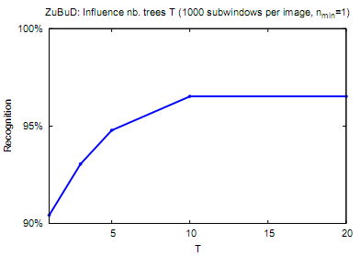
Parameters
Number of trees
more is better

Slide 28
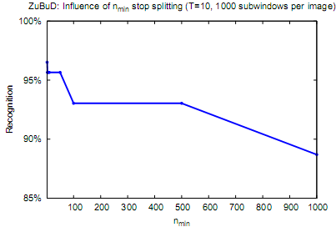
Parameters
Tree depth (minimum node size - n_{min})
deeper is better

Slide 29
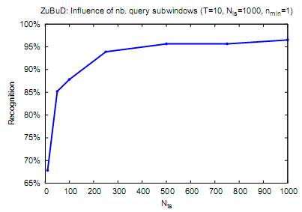
Parameters
Number of query image subwindows
more is better

Slide 30

Algorithm summary
Content-based image retrieval by indexing random subwindows with randomized trees
Fast indexing and prediction
Possible parallelization
Only a few parameters
Incremental mode
Image near-duplicate detection
Dealing with big DBs
Other
Relevance feedback
Sub-image retrieval
Indexing of other types of data (audio)

Slide 31
Other than CBIR, what else is there?
Automatic image annotation
Machine learning techniques
Automatically assigns metadata to new images
Search by keywords
In comparison to CBIR
Queries are maybe more naturally specified by the user
However
……

Slide 32
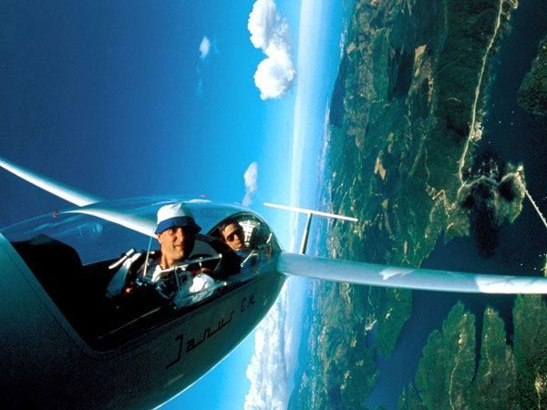
…a picture is worth thousand words

Slide 33

Content-based image retrieval
Applications
Art collections
Photograph archives
Retail catalogs
Medical diagnosis
Crime prevention
The military
Intellectual property
Video retrieval
Web searches

Slide 34









List of CBIR search engines
… and many others…

Slide 35
References
Eakins, J., Graham, M.: Content-based Image Retrieval University of Northumbria at Newcastle (1999)
Maree, R. Geurts, P., Wehenkel, L.: Content-based Image Retrieval by Indexing Random Subwindows with Randomized Trees, ISPJ Transactions on Computer Vision and Applications, Vol.1, pp.46-57 (Jan. 2009)
Schmid, C., Mohr, R.: Local Grayvalue Invariants for image retrieval, IEEE PAMI, Vol.19, No.5, pp.530-534 (1997)

Slide 36
Content-based image retrieval
Questions?
Matija Lukić
matija32@gmail.com

